Slide 1
Chapter 18
Social Networks
and Industry Disruptors
in the Web 2.0 Environment

Slide 2
Learning Objectives
Understand the Web 2.0 revolution, social and business networks and industry and market disruptors.
Describe Google and the search engine industry, the impact on advertisement, and the industry competition.
Understand the concept, structure, types and issues of virtual communities.
Understand the social and business networks and describe MySpace, Flicker, Facebook, CyWorld, and other amazing sites.

Slide 3
Learning Objectives
Understand the person-to-person video sharing and describe YouTube and its competitors.
Describe business networks.
Describe why the travel and hospitality industry is moving so rapidly to Web 2.0.
Describe the concept of P2P landing and the story of ZOPA, and Prosper.

Slide 4
Learning Objectives
Describe how the entertainment industry operated in the Web 2.0 environment.
Describe some of the enablers of the Web 2.0 revolution: blogging, wikis, mushups, etc.
Understand the financial viability that accompanies digital Web 2.0 implementation.
Describe the anticipated future of EC and the Web 3.0 concept.

Slide 5
The Web 2.0 Revolution, Social Networks, Innovations, and Industry Disruptors
Web 2.0
The popular term for advanced Internet technology and applications including blogs, wikis, RSS, and social bookmarking. Web 2.0 offers greater collaboration among Internet users and other users, content providers, and enterprises than Web 1.0
Foundation of Web 2.0
  The Web as a democratic, personal, and do-it-yourself medium of communications

Slide 6
The Web 2.0 Revolution, Social Networks, Innovations, and Industry Disruptors
Representative Characteristics of Web 2.0
  The ability to tap into the collective intelligence of users
  Making data available in new or never-intended ways
  The presence of lightweight programming techniques and tools that let nearly anyone act as a developer
  The virtual elimination of software-upgrade cycles by making everything a perpetual beta or work in progress, and by allowing rapid prototyping using the Web as a platform

Slide 7
The Web 2.0 Revolution, Social Networks, Innovations, and Industry Disruptors
  Users own the data on the site and exercise control over that data
  An architecture of participation and digital democracy that encourages users to add value to the application as they use it
  The creation of new business models
  A rich interactive, user-friendly interface based on Ajax or similar frameworks

Slide 8
The Web 2.0 Revolution, Social Networks, Innovations, and Industry Disruptors
social media
The online platforms and tools that people use to share opinions, experiences, including photos, videos, music, insights and perceptions with each other

Slide 9
The Web 2.0 Revolution, Social Networks, Innovations, and Industry Disruptors
Ground rules of social media:
  Communication in the form of conversation, not monologue
  Participants in social media are people, not organizations
  Honesty and transparency are core values
  It’s all about pull, not push
  Distribution instead of centralization

Slide 10
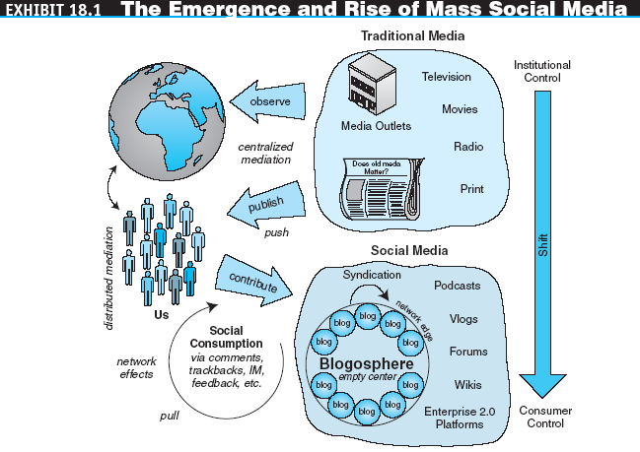
The Web 2.0 Revolution, Social Networks, Innovations, and Industry Disruptors

Slide 11
The Web 2.0 Revolution, Social Networks, Innovations, and Industry Disruptors
Industry and Market Disruptors
  disruptors
  Companies that introduce a significant change in their industries thus cause disruption in the way business is done
  Checklist of questions to help identify disruptors
    Is the service or product simpler, cheaper, or more accessible?
    Does the disruptor change the basis of competition with the current suppliers?
    Does the disruptor have a different business model?
    Does the product or service fit with what customers value and pay for?

Slide 12
The Web 2.0 Revolution, Social Networks, Innovations, and Industry Disruptors
  The top four killers of would-be-disruptors:
    Is the disruptor trying to be beat the mainstream supplier at his own game?
    Is the disruptor choosing growth ahead of profits?
    Does the disruptor need to change consumer behavior or to ‘educate’ the customer?
    Is the disruptor saddled with old business processes or an outdated business model?

Slide 13
The Web 2.0 Revolution, Social Networks, Innovations, and Industry Disruptors
  The potential for disruption and opportunity
    The best future companies are likely those that will create innovative new ways to facilitate collaboration by the hundreds of millions of us who can be reached and embraced by effective architectures of participation
    The big winners will enable us and encourage us to take control, contribute, shape, and direct the designs of the products and services that we in turn consume

Slide 14
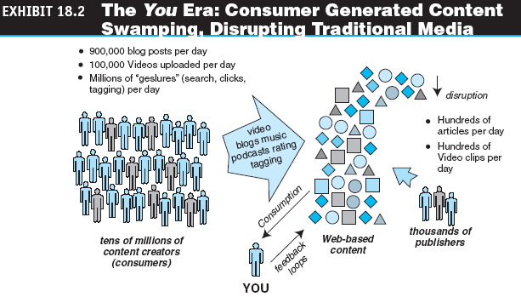
The Web 2.0 Revolution, Social Networks, Innovations, and Industry Disruptors

Slide 15
Google and Company:
Advertisement and Search Engines
search engine
A document retrieval system designed to help find information stored on a computer system, such as on the web, inside a corporate in proprietary files, or in a personal computer. Search can be conducted from some cell phones as well
How Do Search Engines Work?
  Search engines perform three basic tasks:
    They keep an index of words they find, and where they find them
    They allow users to look for words or combinations of words found in that index
    They search the Internet based on key words

Slide 16
Google and Company:
Advertisement and Search Engines
Search Wars: Google versus Yahoo and Others
  The Web search world changed in 1998 when Google introduced link popularity—counting the number of links and importance of those links—in its search algorithm
  Yahoo! Search is an Internet portal
  Amazon’s a9.com is a search engine with memory
  Microsoft’s MSN Search

Slide 17
Google and Company:
Advertisement and Search Engines
How Does Google Compete?
Froogle
Google Catalogs
Google News
Google Earth
Google maps
Google maps for mobile
Google Scholar
Google Wireless
Google Groups
Google Print
GMail
Google Mini
Google Desktop
Orkut (social networking)

Slide 18
Google and Company:
Advertisement and Search Engines
Answer-Based Search Engines
  Google discontinued its answer-based search in November 2006
Disruptors of Google, Will They Succeed?
  Intelligent search engine
  Wikia.com and collaborative innovation

Slide 19
Virtual Communities
Virtual (Internet) community
A group of people with similar interests who interact with one another using the Internet
  Examples of Communities
    Associations
    Ethnic communities
    Gender communities
    Affinity portals
    Catering to young people
    Mega communities
    B2B online communities
    Social networks

Slide 20
Virtual Communities
Types of Communities
  Transaction and other business
  Purpose or interest
  Relations or practice
  Fantasy
  Social networks
10 important trends within online communities:
  Search communities
  Trading communities
  Education communities
  Scheduled events communities
  Subscriber-based communities
  Community consulting firms
  E-mail-based communities
  Advocacy communities
  CRM communities
  Mergers and acquisitions activities

Slide 21
Virtual Communities
Commercial Aspects of Communities
  Understand a particular niche industry
  Build a site that provides the information necessary to that niche
  Set up the site to mirror the steps a user goes through in the information-gathering and decision-making process
  Build a community that relies on the site for decision support
  Start selling products and services that fit into the decision-support process

Slide 22
Virtual Communities
Key Strategies for Successful Online Communities
  Increase traffic and participation in the community
  Focus on the needs of the members; use facilitators and coordinators
  Encourage free sharing of opinions and information—no controls
  Obtain financial sponsorship
  Consider the cultural environment
  Provide several tools and activities for member use; communities are not just discussion groups
  Involve community members in activities and recruiting
  Guide discussions, provoke controversy, and raise sticky issues

Slide 23
Virtual Communities
Six more success factors
  Handle member data sensitively
  Maintain stability of the Web site with respect to the consistency of content, services, and types of information offered
  Provide fast reaction time of the Web site
  Offer up-to-date content
  Offer continuous community control with regard to member satisfaction
  Establish codes of behavior (netiquette/guidelines) to contain conflict potential

Slide 24
Online Social Networks
social network
A special structure made of individuals (or organizations). It includes the ways in which individuals are connected through various social familiarities
social network analysis
The mapping and measuring of relationships and flows between people, groups, organizations, animals, computers or other information/knowledge processing entities

Slide 25
YouTube & Company:
A Whole New World
YouTube: The Essentials
  YouTube is a consumer media company where people can watch and share original videos worldwide through a Web experience
  On YouTube people can:
    Upload, tag, and share videos worldwide
    Browse millions of original videos uploaded by community members
    Find, join, and create video groups to connect with people who have similar interests
    Customize the experience by subscribing to member videos, saving favorites, and creating playlists
    Integrate YouTube videos on Web sites using video embeds or APIs
    Make videos public or private

Slide 26
YouTube & Company:
A Whole New World
The Business and Revenue Models
  Advertisements were launched on the site beginning in March 2006
  In April 2006, YouTube started using Google AdSense
  Given its traffic levels, video streams, and page views, some have calculated YouTube’s potential revenues could be in the millions per month

Slide 27
YouTube & Company:
A Whole New World
Implementation Difficulties: The Copyright Problem
  Brazilian Court Case
The Competition
  Several start ups completely dedicated to video sharing
  Several social networks such as MySpace added video sharing as one of their offerings

Slide 28
Business and Entrepreneurial Networks
business network
A group of people that have some kind of commercial/business relationship
  Example: Linkedin

Slide 29
Business and Entrepreneurial Networks
  entrepreneurial networks
  Social organizations offering different types of resources to start or improve entrepreneurial projects or startups
  social marketplace
  Derived from the combination of social networking and marketplaces, such that a social marketplace acts like an online community harnessing the power of one’s social networks for introducing, buying, and selling of products, services, and resources, including people’s own creations

Slide 30
Travel and Tourism—
The EC Revolution Is Here
The Major Players
  The service providers
  The travel agents and other intermediaries
  Aggregators and comparison price provider
  Traveler service providers
  Social networks

Slide 31
Travel and Tourism—
The EC Revolution Is Here
The Impacts of the Web
  Representative impacts
    Increase in power and profitability
    Decrease in power and profitability
    Lose market share altogether
  Online collaboration

Slide 32
Travel and Tourism—
The EC Revolution Is Here
Travelers and Social Networks
  WAYN (Where Are You Now? )
  Travel recommendation
  Corporate social network
  Providers networks

Slide 33
ZOPA and P2P Lending:
Will They Disrupt Banking?
person-to-person lending
Money is lent directly to a consumer rather than “selling” money to the bank and the banks then loan their money to consumers

Slide 34
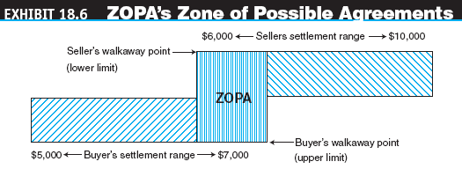
ZOPA and P2P Lending:
Will They Disrupt Banking?

Slide 35
ZOPA and P2P Lending:
Will They Disrupt Banking?
ZOPA Ltd .
  Securing the loans
    Conducting a credit rating investigation
    Checking people’s e-bay rating (if available)
    Checking the borrowers profile (if available online)
    Only one account is permitted for each borrower
    Checking the possibility of identity theft by a borrower by asking questions about past borrowing, demographics, etc.

Slide 36
ZOPA and P2P Lending:
Will They Disrupt Banking?
  The revenue model
    ZOPA takes 0.5% of the loan amount from both the lender and the borrower
    There are no hidden fees and the only other (optional) cost to the lender is the insurance (plus the fees that ZOPA takes for arranging the insurance)

Slide 37
ZOPA and P2P Lending:
Will They Disrupt Banking?
PROSPER
  Borrowers create a loan listing on prosper, specifying amount needed, the purpose of the loan, and the interest rate they are willing to pay
  Lenders review loan listings and bid to fund only the ones they choose using a bidding process
  Prosper displays borrower credit and services the loan
  Group leaders manage borrower groups and use their reputation to get great rates for borrowers

Slide 38
Entertainment Web 2.0 Style: From Communities to Entertainment Marketplaces
Entertainment and Business Communities
  Last.fm
  Mixi
  Second Life

Slide 39
Entertainment Web 2.0 Style: From Communities to Entertainment Marketplaces
Advertising Movies and Events in Communities
Online Marketplace for Movies
The Hype Machine
Internet Series

Slide 40

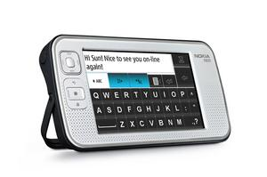
Entertainment Web 2.0 Style: From Communities to Entertainment Marketplaces
Mobile Web 2.0 Devices for Entertainment and Work
  iPhone
  Yahoo! Go
  Nokia’s N800 Internet Tablet

Slide 41
Technology Support:
From Blogger.com to Infrastructure Services
Web 2.0 and Social Software
  Social software enables people to rendezvous, connect, or collaborate through computer-mediated communication. Many advocates of these tools believe they help create actual community with its structures
  Collaborative software applies to cooperative work systems and is usually narrowly applied to software that enables work functions

Slide 42
Technology Support:
From Blogger.com to Infrastructure Services
  Tools for blogging
  Wiki tools
  Tools for RSS and podcasting
  Wikis and blogs are replacing e-mail
  Enterprise wiki and blog tools
    Traction
    Socialtext
  Blogging for business

Slide 43
Technology Support:
From Blogger.com to Infrastructure Services
mashups
Tools that combine data from two (or more) Web sites to create new applications
Personalization Tools
  Users can create highly personalized pages that are constantly updated with information like news and stock prices as well as view photos, use a calculator, etc., all in one page

Slide 44
Technology Support:
From Blogger.com to Infrastructure Services
Development Tools
  To implement Web 2.0 applications, you may need a development framework for building rich media Internet applications
social bookmarking
A Web Service for sharing Internet bookmarks. The sites are a popular way to store, classify, share, and search links through the practice of folksonomy techniques on the Internet and intranets

Slide 45
Technology Support:
From Blogger.com to Infrastructure Services
Tools that Support Applications
  File-sharing tools
  Alexa: Web traffic information provider
  Mobile phones and social networks
Infrastructure Support
  Example of use of Web 2.0 technologies in a manufacturing company:
    Ratings
    Forums
    Blogs
    E-newsletters
    Streaming video
    Contests
    Search engine
  The need for very rich media

Slide 46
Web 2.0, Social Networks, and E-Commerce
Why Is There an Interest?
  Web 2.0 applications and especially social networks attract a huge number of visitors
  Social networks are spreading rapidly and many of them cater to a specific segment of the population
  Young visitors today will grow up and spend money
Retailers stand to benefit from online communities in several important ways

Slide 47
Web 2.0, Social Networks, and E-Commerce
Advertising
  Viral marketing
  Classifieds and job listing
  Mobile advertising
Shopping
Feedback from customers
  Conversational marketing
  Risks

Slide 48
Web 2.0, Social Networks, and E-Commerce
Other Revenue Generation Strategies in Social Networks
  Offer premium service for monthly or per service fee
  Organizations partner with the social networks, paying them a monthly service fee
  Some social networks have a network of thousands of local physical venues where members can meet; these venues may pay a fee to be associated with the network

Slide 49
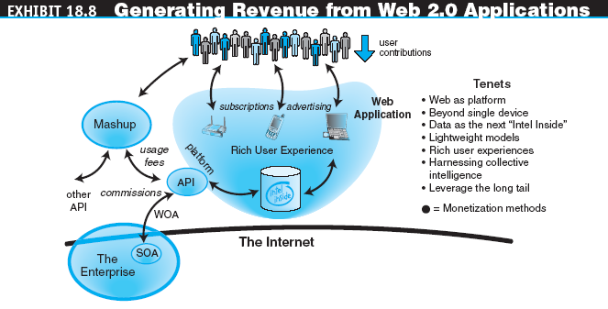
Web 2.0, Social Networks, and E-Commerce

Slide 50
Web 2.0, Social Networks, and E-Commerce
Strategies for making the most of Web 2.0 applications:
  Three direct ways to monetize Web 2.0:
    Advertising
    Subscriptions
    Commissions

Slide 51
Web 2.0, Social Networks, and E-Commerce
Some indirect ways that lead to revenue growth, user growth, and increased resistance to competition—which in turn lead to increased subscriptions, advertising, and commission revenue—are:
  Strategic acquisition
  Maintaining control of hard to recreate data sources
  Building attention trust
  Turning applications into platforms
  Fully-automated online customer self-service

Slide 52
The Future of EC and Web 3.0
Web 3.0: What’s Next?
  Web 3.0 will deliver a new generation of on-demand business applications
  Web 3.0 technologies
    Application program interface (API) services
    Aggregation services
    Application services
      voice commerce (v-commerce)
      An umbrella term for the use of speech recognition to allow voice activated services including Internet browsing and e-mail retrieval
    Serviced clients

Slide 53
The Future of EC and Web 3.0
Integrating the Marketplace with the Marketspace
  Semantic Web
  An evolving extension of the Web in which Web content can be expressed not only in natural language but also in a form that can be understood, interpreted, and used by intelligent computer software agents, permitting them to find, share, and integrate information more easily

Slide 54
The Future of EC and Web 3.0
Mobile Social Networks
  Future threats
    Security concern
    Lack of Net neutrality
    Copyright complaints
    Choppy connectivity

Slide 55
Managerial Issues
What impacts on business is EC expected to make?
What are the impacts of the Web 2.0 boom?
Should we explore Web 2.0 collaboration?
How shall we start?
Do we need a community?
How should we deal with Web 2.0 risks?

